Slide 1

AN INTRODUCTION TO BASIC POWER BI REPORT USAGE

Slide 2

Power BI
An introduction
Power BI is a powerful business intelligence tool that is being used to replace much of our legacy Excel reporting. Because it is a web-based tool, it does function differently from traditional Excel reports.
This document will cover Power BI features and general guidelines for interacting with our reports at a high level. There is also a video at the end of the page produced by Guys in a Cube from Microsoft. This video covers the main points covered here, plus some additional ways to interact with Power BI reports.
It should be noted that Power BI services and tools are updated on a monthly basis. As such, the location or appearance of some features, may change from the publishing date of this document.
Let’s get started!

Slide 3
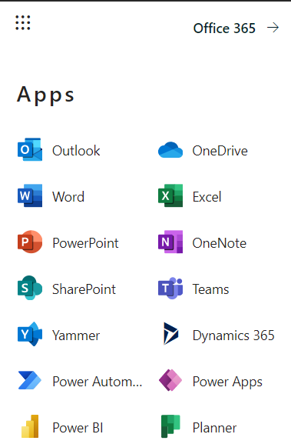

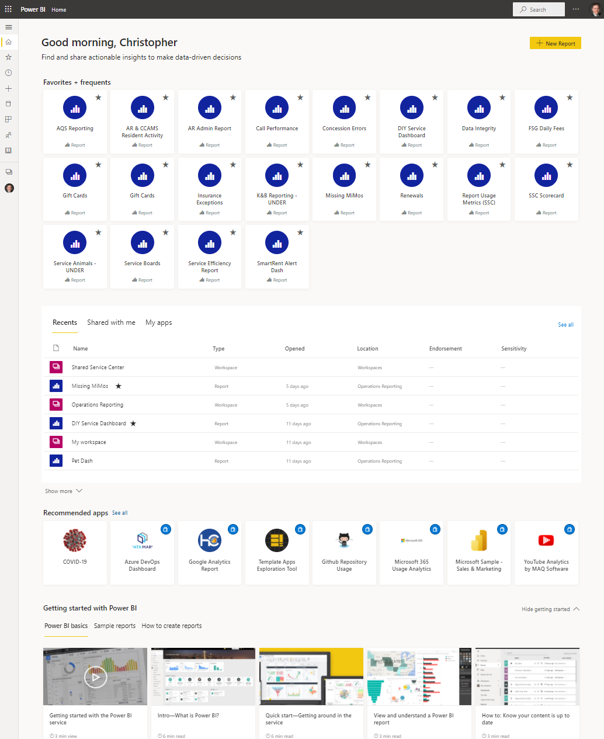
Access & Home Page
1
Power BI is accessed on the AIR Communities Intranet using the App Menu in the top left corner of the page.
You will be taken to your homepage when you first log into the Power BI website.
Home Page Sections:
2
Favorites and Frequents - Frequently accessed and Favorited files
Recent and other reports
  Recents - list of recently accessed files
  Shared With Me - Reports shared with you from other users.
  My Apps - Apps are a tool that are not commonly used for AIR reporting
3
Microsoft provided Power BI training resources.

Slide 4
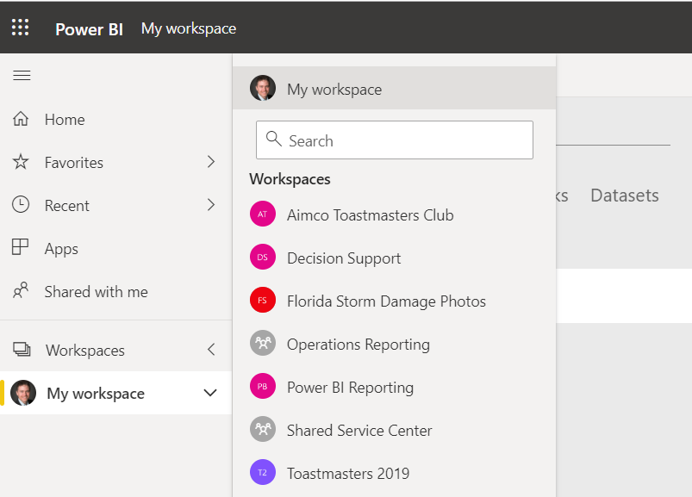
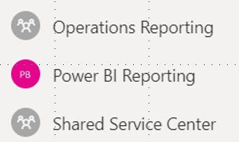
Accessing Workspaces
Workspaces are like folders where reports and data are kept in Power BI. When you initially log in you will be in My Workspace. My Workspace typically stores reports that you created but will not contain general AIR reports.
You must access a Workspace in order to get to standard AIR reports. Many reports are contained in the Operations Reporting Workspace. To access this space:
  Click Workspaces
  Click Operations Reporting
2
1
2

Slide 5
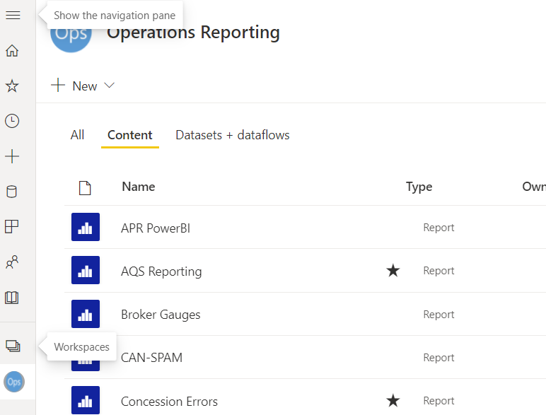
Accessing Reports
Once you have opened the appropriate workspace, click on Content to access a list of reports to which you have access.
* Many of our reports are commonly referred to as dashboards. In the Power BI world, this is not technically an accurate description, and you will typically want to access Reports instead.

Slide 6
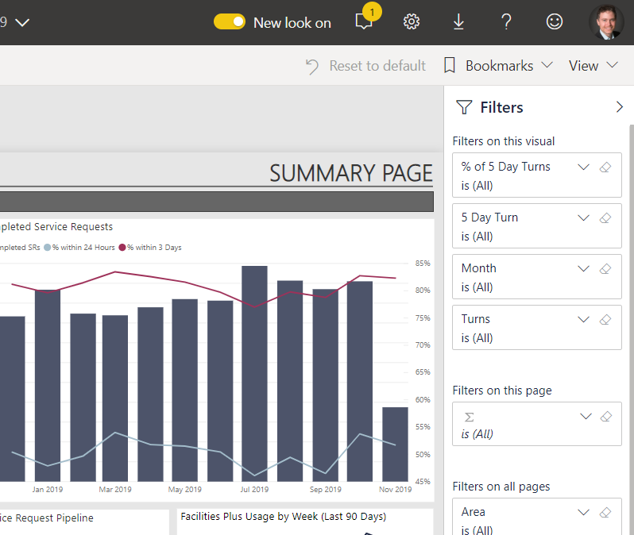
Filtering Reports
Option 1 - Filter Pane
Once you have accessed a report, there are three ways to filter the information on each page.
Most reports are built to use the filter pane, which is located on the right side of the report’s window. The pane toggles between hidden and visible by using the “<“ or “>” buttons.
Filters are grouped to apply to all pages, this page, or individual visuals (charts, graphs, etc.). Be sure you’re working with the correct filter group!

Slide 7
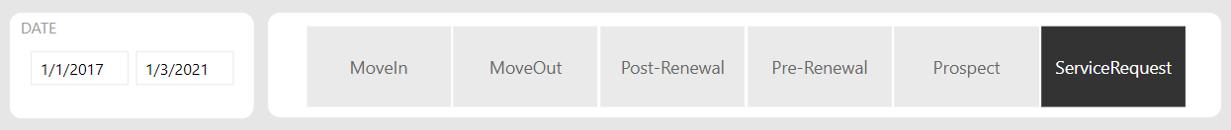
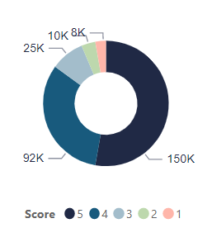
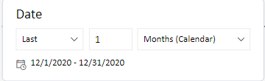
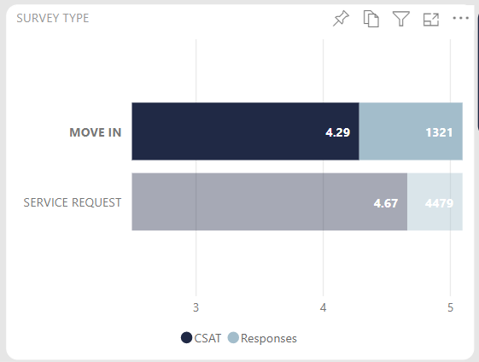
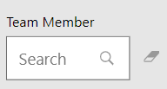
Filtering Reports
Option 2 – Slicers and Visuals
Slicers are visuals on a page that are used for filtering the data on the page. Some examples of common slicer types that can be interacted with directly in the report page are shown to the right.
You can also click directly on charts and graphs to quickly apply additional filters. For example, in the Survey Type bar graph to the right, clicking on the Move In bar will filter the rest of the visuals on that report page to show only move in related data.

Slide 8
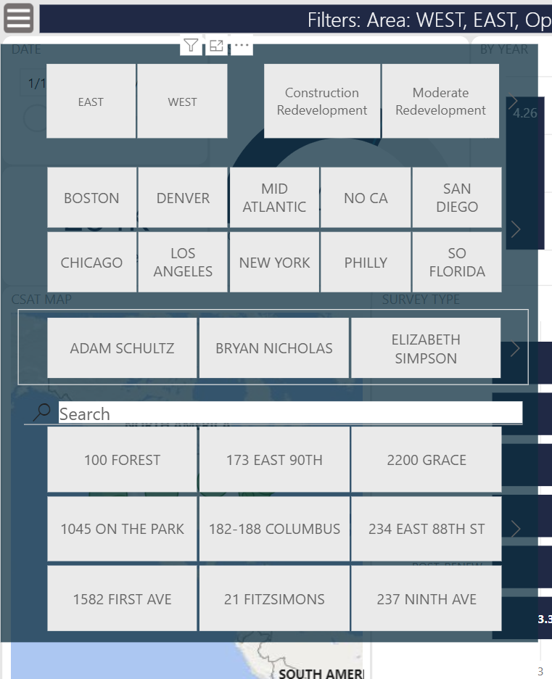
Filtering Reports
Part 3 - Filter Menus
Filter menus can still be found in some older reports, although it is a feature that is being retired in favor of the filter pane mentioned previously. Most often, they can be opened by clicking on a hamburger menu towards the top of the page.
Filter menus display slicers that can be used to filter the visualizations on the report page. They are interactive, and menu items in some fields may disappear as filters are applied in other fields

Slide 9
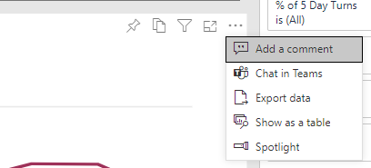
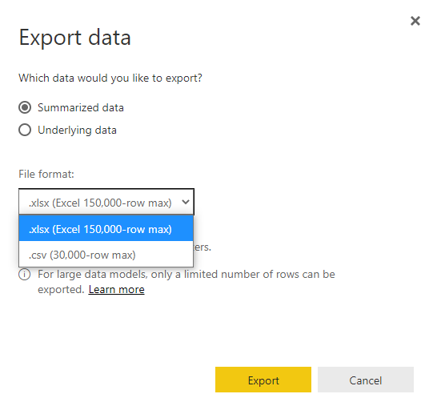
Extracting Data
You can extract data from specific visualizations for analysis in Excel.
In the top right corner of each visualization, click on the ellipsis button.
Click on Export Data.
Select whether you want to export
summarized or full underlying data.
Select whether you want to get it as
an Excel file or a CSV file.
5. Click Export.

Slide 10
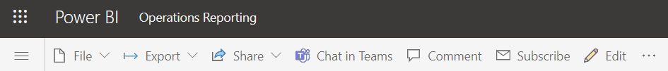
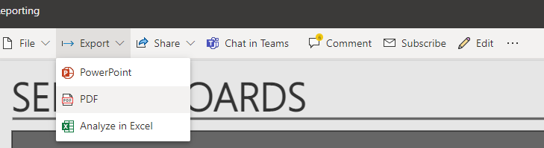
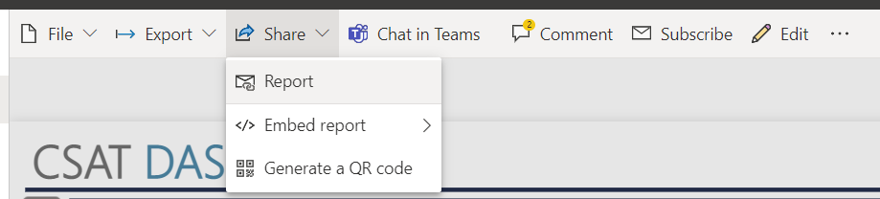

Report Menus
Power BI Menus
In the Power BI menu at the top of the page, there are several features that you will find useful.
Export: Exports report pages to PDF or PowerPoint. Excel analysis is not an option at this time.
Share: From the Share menu, click on Report to share this report with someone. If they cannot open it, then they should be able to be able to submit an access request directly from the report.
Chat in Teams: Interacts with Microsoft Teams. AIR uses WebEx Teams, but not Microsoft Teams. This menu item can be ignored.
Comment: This feature is not typically used in AIR reporting.

Slide 11
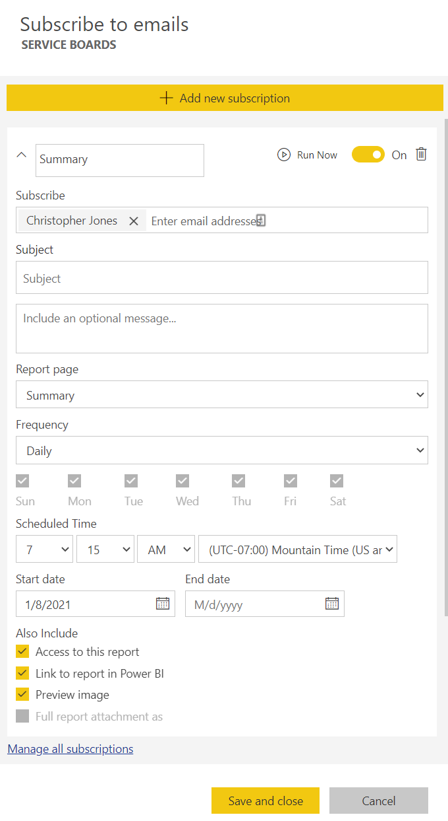


Report Menus
Power BI Menus
Other features that you will find useful.
Subscribe: Schedule a reminder email to be sent out at a frequency which you can choose.
Favorite: Flag report as a favorite. This will cause the report to be included in the favorites section at the top of the home page.

Slide 12
Thank you for taking the time to learn more about how to use Power BI!
The following video provides a similar breakdown to the information provided in this slideshow. It references Power BI Apps, but the interaction with the visualizations is generally the same as interacting with our reports.
https://youtu.be/hbHs91E8MBw
Please direct any questions regarding Power BI reports to Evan Martoia on the Decision Support team and he will ensure the proper analyst responds to any questions you may have.
Evan.Martoia@AirCommunities.com

